Slide 1
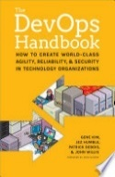
The DevOps Handbook HOW TO CREATE WORLD-CLASS AGILITY, RELIABLE, & SECURITY IN TECHNOLOGY ORGANIZATIONS Gene Kim, Jez Humble, Patrick Debois, & John Willis
Part III – The First Way: The Technical Practices of Flow
09 Create the Foundations of Our Deployment Pipeline
Prepared by Dr. Fawzi Albalooshi

Slide 2
Introduction
In this chapter, the author discusses how:
to build the mechanisms that will enable us to create environments on demand;
expand the use of version control to everyone in the value stream;
make infrastructure easier to rebuild than repair;
and ensure that developers run their code in production-like environments along every stage of the software development life cycle.

Slide 3
Enable On-demand Creation of Dev, Test, and Production Environments
In this step, we want developers to run production-like environments on their own workstations, created on demand and self-serviced.
A production-like environment is a term used in software development to describe an environment that closely mirrors the production environment. This could be a staging, testing, or development environment that has been configured to replicate the conditions of the production environment as closely as possible.
The purpose of a production-like environment is to catch any issues or bugs that might not have been evident in the development or testing environments. It allows developers to validate their code under conditions that simulate the live production environment before the code is deployed. Developers can run and test their code in production-like environments as part of their daily work, providing early and constant feedback on the quality of their work.

Slide 4
Enable On-demand Creation of Dev, Test, and Production Environments
Here are some examples of production-like environments:
Staging/ Pre-Production Environment: This is a common production-like environment where the final version of the application is deployed for final testing. It mirrors the production environment in terms of hardware, software, and network configurations.
User Acceptance Testing (UAT) Environment: This environment is used by end-users to validate the functionality and performance of the application before it goes live. It replicates the production environment to ensure users have a realistic experience.
Performance Testing Environment: This setup is used to test the application's performance under various load conditions. It mimics the production environment to identify any performance bottlenecks or issues.
Disaster Recovery Environment: This environment is used to test the application's ability to recover from failures. It replicates the production environment to ensure that disaster recovery plans are effective.
These environments help in identifying and fixing issues before the application is deployed to production, reducing the risk of failures and ensuring a smooth user experience.

Slide 5
Enable On-demand Creation of Dev, Test, and Production Environments
Examples of common production environments tailored to the specific needs of the software being deployed:
Web Servers: These environments host web applications and websites. Examples include Apache, Nginx, and Microsoft IIS.
Database Servers: These environments manage databases for applications. Common examples are MySQL, Oracle, and Microsoft SQL Server.
Application Servers: These environments run application logic and services. Examples include Apache Tomcat, JBoss, and IBM WebSphere.
Cloud Environments: These are hosted on cloud platforms like AWS, Azure, and Google Cloud.
Containerized Environments: These use containerization technologies like Docker and Kubernetes to deploy and manage applications in isolated environments.
Microservices Environments: These environments support applications built using microservices architecture, often using tools like Kubernetes, Istio, and Consul.
Mobile Environments: These are used for deploying mobile applications on platforms like iOS and Android, often using services like Firebase or AWS Mobile Hub.

Slide 6
Enable On-demand Creation of Dev, Test, and Production Environments
In some cases, a production-like environment might be a mirror of the production environment, using the same hardware, software, and data configurations. In other cases, it might simply simulate key aspects of the production environment, such as network latency or database size.
Instead of merely documenting the specifications of the production environment in a document or on a wiki page, we create a common build mechanism that creates all our environments, such as for development, testing, and production. By doing this, anyone can get production-like environments in minutes, without opening a ticket, let alone having to wait weeks.
To do this requires defining and automating the creation of our known, good environments, which are stable, secure, and in a risk-reduced state, embodying the collective knowledge of the organization. All our requirements are embodied, not in documents or as knowledge in someone’s head, but codified in our automated environment build process.

Slide 7
Enable On-demand Creation of Dev, Test, and Production Environments
Instead of Operations manually building and configuring the environment, we can use automation for any or all of the following:
Copying a virtualized environment.
Building an automated environment creation process that starts from “bare metal”.
Using “infrastructure as code” configuration management tools.
Using automated operating system configuration tools.
Assembling an environment from a set of virtual images or containers.
Spinning up a new environment in a public cloud, private cloud, or other PaaS.
Because we have carefully defined all aspects of the environment ahead of time, we are not only able to create new environments quickly but also ensure that these environments will be stable, reliable, consistent, and secure. This benefits everyone.

Slide 8
Enable On-demand Creation of Dev, Test, and Production Environments
Virtualized environments refer to the creation of a simulated, or virtual, computing environment as opposed to a physical one. This often includes computer-generated versions of hardware, operating systems, storage devices, and more.
Creating a virtual computing environment allows you to run an operating system within an app window on your desktop, simulating a separate computer. Whether you’re experimenting with different operating systems, testing software, or creating a sandboxed environment, virtual machines (VMs) are a powerful tool. https://youtu.be/FZR0rG3HKIk?feature=shared
Bare metal refers to a computer system that does not have a base operating system (OS) or installed applications. It is the computer’s hardware assembly, structure, and components that are installed with either the firmware or basic input/output system (BIOS) software utility or no software at all. In other words, “bare metal” involves provisioning and configuring physical servers or devices from scratch, without any pre-installed operating system or software.

Slide 9
Enable On-demand Creation of Dev, Test, and Production Environments
Infrastructure as code: Infrastructure as Code (IaC) is a method of managing and provisioning computing infrastructure with machine-readable definition files, rather than physical hardware configuration or interactive configuration tools.
IaC is a method of managing and provisioning IT infrastructure using code, rather than manual configuration. It allows teams to automate the setup and management of their infrastructure, making it more efficient and consistent. This is particularly useful in the DevOps environment, where teams are constantly updating and deploying software. What is Infrastructure as Code (IaC)? – GeeksforGeeks
https://youtu.be/Kjq4vw_hMjE

Slide 10
Enable On-demand Creation of Dev, Test, and Production Environments
Automated operating system configuration tools: several tools are available to automate operating system configuration. Tools that can streamline processes, improve efficiency, and reduce manual intervention include, Auvik, Redwood, RunMyJobs, Atera, Tidal Workload Automation, SuperOps, and others. These tools empower IT professionals to efficiently manage and automate various aspects of operating system configuration.
Assembling an environment from a set of virtual images or containers: a virtual image typically refers to a computer file that behaves like an actual computer. This file is often called an image and can run in a window as a separate computing environment. It’s often used to run a different operating system or even to function as the user’s entire computer experience. Popular tools include Docker, VirtualBox, VMware, and Others.
https://youtu.be/eyNBf1sqdBQ?feature=shared

Slide 11
Enable On-demand Creation of Dev, Test, and Production Environments
Operations benefit from this capability to create new environments quickly because automation of the environment creation process enforces consistency and reduces tedious, error-prone manual work. Furthermore, Development benefits by being able to reproduce all the necessary parts of the production environment to build, run, and test their code on their workstations.
By providing developers with an environment, they fully control, we enable them to quickly reproduce, diagnose, and fix defects, safely isolated from production services and other shared resources. They can also experiment with changes to environments, as well as to the infrastructure code that creates, further creating shared knowledge between Development and Operations.

Slide 12
Create Our Single Repository of Truth for the Entire System
We must ensure that all parts of our software system can be configured and managed using a source of truth that is maintained in version control which has become a mandatory practice of individual developers and development teams.
When developers put all their application source files and configurations in version control, it becomes the single repository of the truth that contains the precise intended state of the system. However, because delivering value to the customer requires both our code and the environments they run in, we need our environments in version control as well. In other words, version control is for everyone in our value team, including QA, Operations, Infosec, as well as Development.

Slide 13
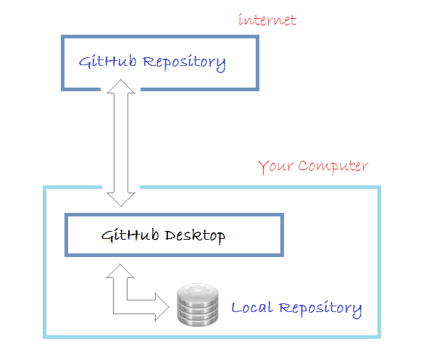
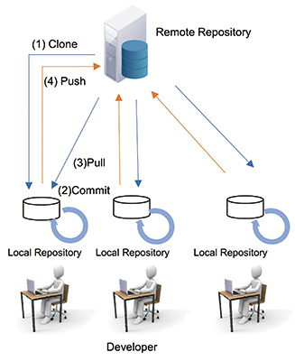
Create Our Single Repository of Truth for the Entire System

Slide 14
Create Our Single Repository of Truth for the Entire System
To ensure that we can restore production service repeatedly and predictably (and, ideally, quickly) even when catastrophic events occur, we must check in the following assets to our shared version control repository:
All application code and dependencies.
Any script used to create database schemas, application reference data, etc.
All the environment creation tools and artifacts described in the previous step.
Any file used to create containers.
All supporting automated tests and any manual test scripts.
Any script that supports code packaging, deployment, database migration, and environment provisioning.
All project artifacts.
All cloud configuration files.
Any other script or configuration information required to create the infrastructure that supports multiple services

Slide 15
Create Our Single Repository of Truth for the Entire System
We may have multiple repositories for different types of objects and services, where they are labeled and tagged alongside our source code. I.e., local, remote, global, subject-based, research-based, national, institutional, database .. etc.
It is not sufficient to re-create the previous state of the production environment; we must also be able to re-create the entire pre-production and build processes, such as the development and test environments.
https://youtu.be/IeXhYROClZk

Slide 16
Make Infrastructure Easier to Rebuild Than to Repair
When we can quickly rebuild and re-create our applications and environments on demand, we can also quickly rebuild them instead of repairing them when things go wrong.
To ensure consistency of our environments, whenever we make production changes (configuration changes, patching, upgrading, etc.), those changes need to be automatically replicated everywhere in our production and pre-production environments, as well as in any newly created environments. The changes must also be available into version control.

Slide 17
Modify Our Definition of Development “Done” to include Running in Production-Like Environments
Now that our environments can be created on demand and everything is checked into version control, our goal is to ensure that these environments are being used in the daily work of Development. We need to verify that our application runs as expected in a production-like environment long before the end of the project or before our first production deployment.
Our goal is to ensure that Development and QA are routinely integrating the code with production-like environments at increasingly frequent intervals throughout the project. We do this by expanding the definition of “done” beyond just correct code functionality: at the end of each development interval, or more frequently, we have integrated, tested, working, and potentially shippable code, demonstrated in a production-like environment

Slide 18
Conclusion
The fast flow of work from Development to Operations requires that anyone can get production-like environments on demand.
By allowing developers to use production-like environments even at the earliest stages of a software project, we significantly reduce the risk of production problems later.
This is one of the many practices that demonstrate how Operations can make developers far more productive.
Furthermore, by having all production artifacts into version control, we have a “single source of truth” that allows us to re-create the entire production environment in a quick, repeatable, and documented way, using the same development practices for Operations work as we do for Development work.

Slide 19
Tool Support - Environments
One way to have a production-like environment in GitHub is to use “environments” for deployment. Environments are used to describe a general deployment target like production, staging, or development¹. You can also use different “branches” for different environments, such as a master branch for production, a develop branch for testing, and feature branches for development². Another option is to use a tool like “Garden” that creates production-like dev environments on Kubernetes³.
Source: Conversation with Bing, 9/12/2023
Using environments for deployment - GitHub Docs. https://docs.github.com/en/actions/deployment/targeting-different-environments/using-environments-for-deployment
GIT Dev/Testing/Production Environment Best Practices. https://stackoverflow.com/questions/19432586/git-dev-testing-production-environment-best-practices
Why our dev environments need to be more production-like - Garden. https://garden.io/blog/production-like-dev-environments

Slide 20
Tool Support - Containers
There are different ways to use containers in GitHub, depending on your needs. You can use the “Container registry” to store and manage container images within your organization or personal account and associate them with a repository¹. You can also use “service containers” to host services that you need to test or operate your application in a workflow, such as a database or a memory cache². Additionally, you can use the “GitHub Container Registry” to improve how you handle containers within GitHub Packages, and enforce access policies, use a standard base image, and share across the organization³.
Source: Conversation with Bing, 9/12/2023
Working with the Container registry - GitHub Docs. https://docs.github.com/en/packages/working-with-a-github-packages-registry/working-with-the-container-registry
About service containers - GitHub Docs. https://docs.github.com/en/actions/using-containerized-services/about-service-containers
Introducing GitHub Container Registry - The GitHub Blog. https://github.blog/2020-09-01-introducing-github-container-registry/

